Slide 1

MyTutor
By Dean Marques

Slide 2
What is MyTutor?
MyTutor is a booking service that can be used to book a tutor for after school appointments
Provide clients with easy-to-use booking service
Tutors are a popular resource children and teenagers use to work on school work
Having a dedicated app makes it easily accessible

Slide 3
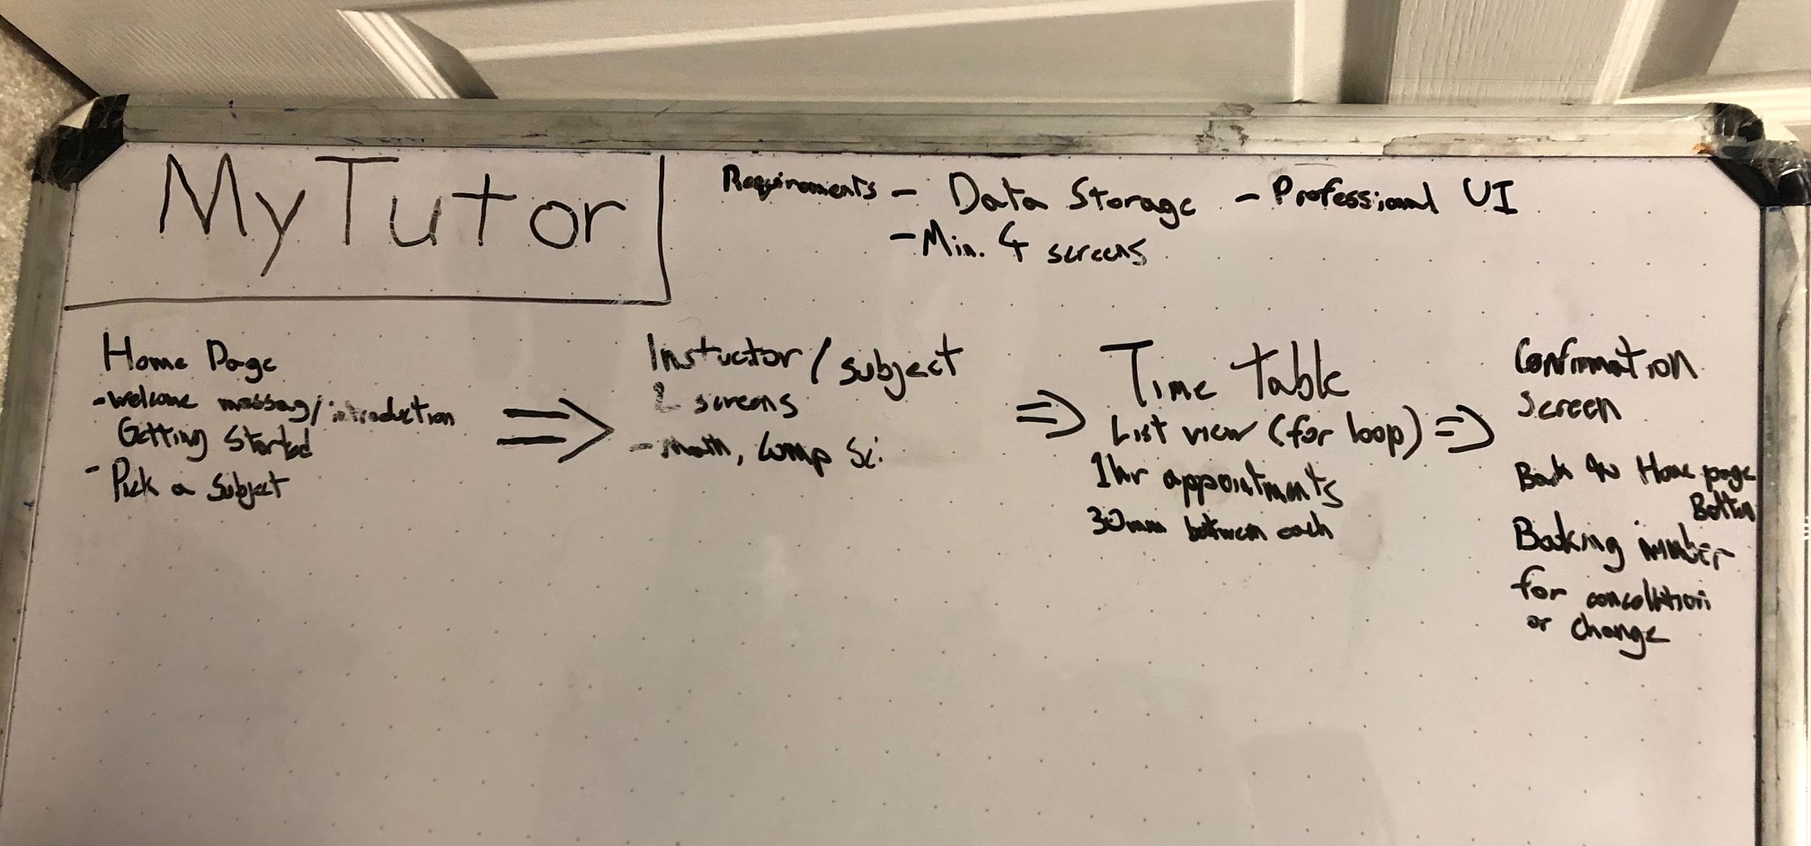
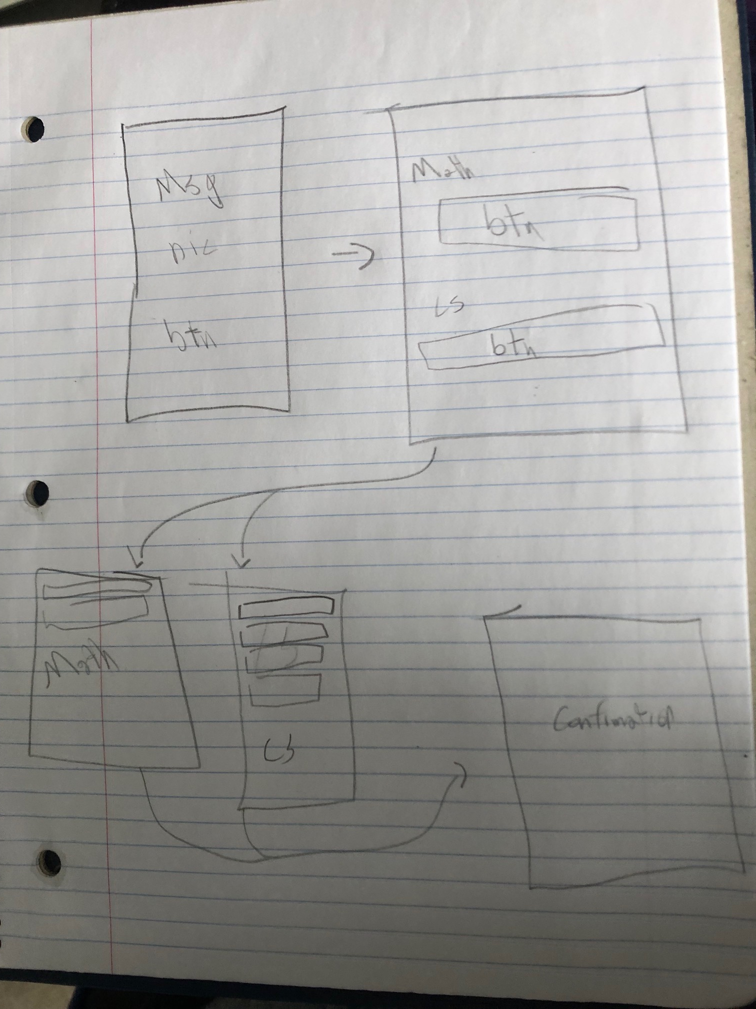
Planning & Design
Flow chart to figure out structure of app
Using constraint and linear layout for structure of each page
Sequentially goes through each page
Simplistic, easy to use
Most user who would use this application are parents
Target demographic of age 35-50 years old
Parents are typically not well-versed in technology

Slide 4
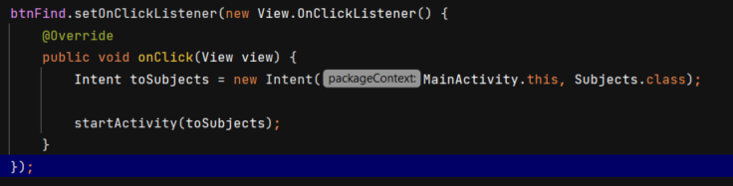
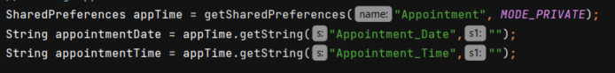
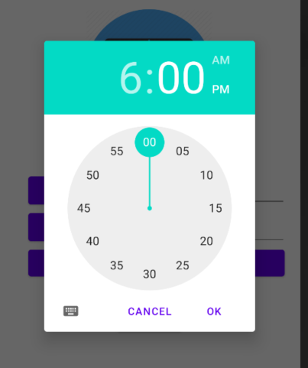
Implementation
Using intent to cycle through screens
Date and time picker to book appointment
Added time restraints for bookings
Shared Preferences to store appointment data

Slide 5
User-guide
Open Application, select find my tutor to start
Select subject you need to be tutor in
Choose appointment time between 3:00pm and 8:00pm
After choosing appointment, you are directed to a confirmation screen that shows your booking

Slide 6
Demo

